Slide 1

TECHNICAL REPORT
PRESENTATION ON DBC FINAL PROJECT

Slide 2
ADMINISTRATIVE ASSISTANT MANAGER (ADAM)
Written By : Elvis Kojo Nutsukpo
2024

Slide 3
Table of Contents
Overview
System Architecture
Installation and Setup
Features and Functionalities
Employee Management
Asset Management
Incoming Letters Management
Outgoing Letters Management
Employee Attendance
Payments Management
User Management
Database Schema
User Interface
Security
Testing
Conclusion

Slide 4
OVERVIEW
The Administrative Assistant Manager is a web-based application developed using Laravel 10 and Bootstrap Blade templates. This system is designed to manage and streamline various administrative tasks within an organization, including employee management, asset tracking, letter management, employee attendance, payments, and user management. The system provides a user-friendly interface and efficient functionality to enhance the productivity and organization of administrative processes.

Slide 5
PROBLEM STATEMENT
In many organizations, administrative tasks such as employee management, asset tracking, letter management, employee attendance, payments, and user management are often handled manually or through disparate systems. This can lead to inefficiencies, errors, and a lack of cohesion in managing administrative processes. The lack of an integrated and user-friendly system to streamline these tasks can result in decreased productivity, increased operational costs, and potential data inaccuracies.
Organizations need a comprehensive solution that can centralize and simplify these administrative tasks, providing an intuitive interface and efficient functionality to enhance productivity and organization. The current tools and methods in use may not adequately address the complexities and volume of administrative work, leading to fragmented workflows and challenges in maintaining accurate records and consistent processes.

Slide 6
PROJECT SCOPE
The Need for an Administrative Assistant Manager
To address these issues, there is a need for a robust, web-based application that can integrate various administrative functions into a single platform. The Administrative Assistant Manager, developed using Laravel 10 and Bootstrap Blade templates, aims to fulfill this need by offering a centralized system to manage and streamline:
Employee Management: Efficiently track and manage employee information, roles, and responsibilities.
Asset Tracking: Keep accurate records of organizational assets, their usage, and status.
Letter Management: Organize and manage incoming and outgoing letters with ease.
Employee Attendance: Simplify the process of clocking in and out, and maintain accurate attendance records.
Payments: Manage payroll and payment processing efficiently.
User Management: Control user access and maintain security over administrative functions.
By providing a user-friendly interface and efficient functionalities, the Administrative Assistant Manager enhances the productivity and organization of administrative processes, ensuring that tasks are completed accurately and efficiently, thus supporting the overall operational effectiveness of the organization.

Slide 7
System Architecture
The system is built using the Model-View-Controller (MVC) architecture pattern provided by Laravel. This structure separates the application's data, user interface, and control logic into three interconnected components.
Model: Handles the data and business logic. Represents the database structure and relationships.
View: Manages the display of information. Uses Bootstrap for a responsive design.
Controller: Handles the user input and interaction, updating the model and view as needed.

Slide 8
Installation and Setup
Prerequisites
PHP >= 8.1
Composer
MySQL
Laravel 10
Bootstrap
Installation Steps
Clone the repository:
sh
Copy code
git clone https://github.com/your-repo/administrative-assistant-manager.git
cd administrative-assistant-manager
JavaScript

Slide 9
Installation and Setup
Install
Install dependencies:
composer install
npm install
Configure
Configure the environment:
Set up your database credentials in the .env file
Generate
Generate application key:
php artisan key:generate
Run
Run migrations and seed the database:
php artisan migrate --seed
Start
Start the development server:
php artisan serve

Slide 10
Features and Functionalities
Employee Management
Add, edit, and delete employee records
View detailed employee profiles
Search and filter employees
Asset Management
Add, edit, and delete assets
Track asset allocation and status
Generate asset reports
Incoming Letters Management
Record details of incoming letters
Categorize and archive letters
Search and retrieve letters
Outgoing Letters Management
Record details of outgoing letters
Track letter status and delivery
Archive outgoing letters
Employee Attendance
Clock in and clock out functionality
Track daily attendance
Generate attendance reports
Payments Management
Manage employee payments
Record and track payment history
Generate payment reports
User Management
Add, edit, and delete users
Role-based access control
User authentication and authorization

Slide 11
Database Schema
The database schema includes tables for users, employees, assets, incoming letters, outgoing letters, attendance records, and payments.

Slide 12
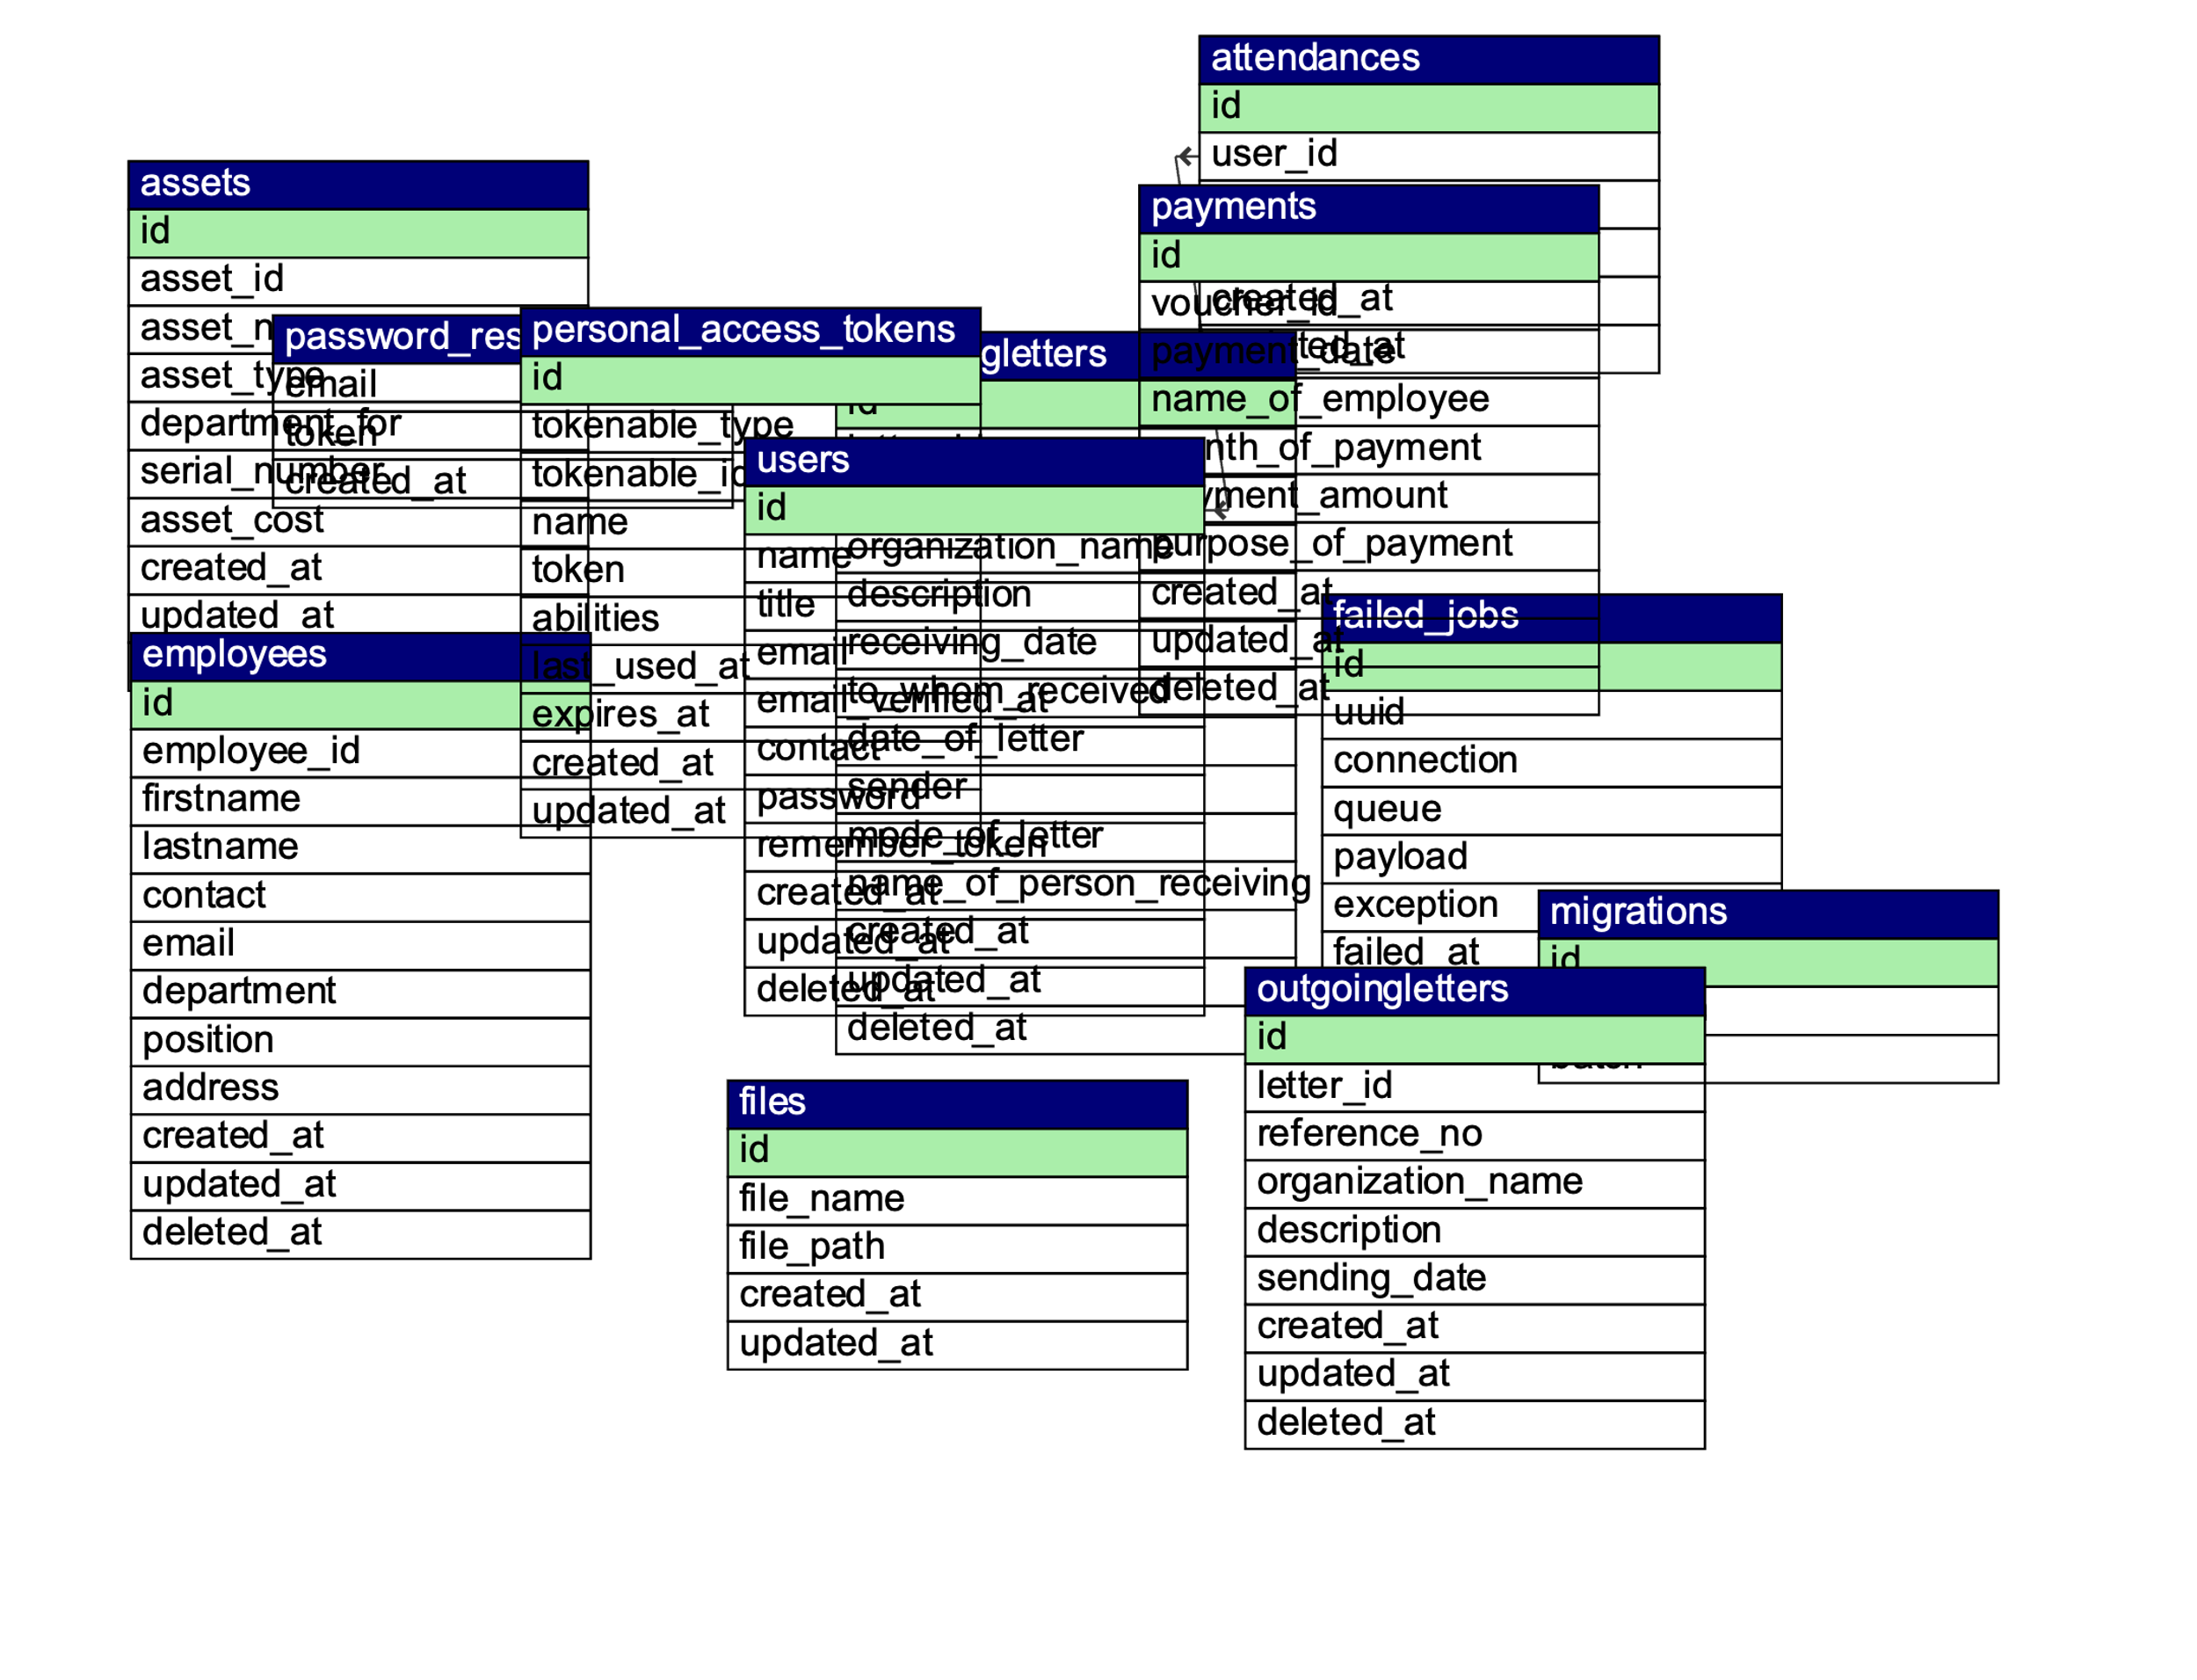
Database Schema ER DIAGRAM

Slide 13
User Interface
The user interface is built using Bootstrap for responsiveness and ease of use. Key components include:
Dashboard: Overview of system metrics and quick access to various sections.
Forms: For adding and editing employees, assets, letters, etc.
Tables: For displaying lists of records with pagination and search functionality.
Modals: For confirmation dialogs and detailed views.

Slide 14
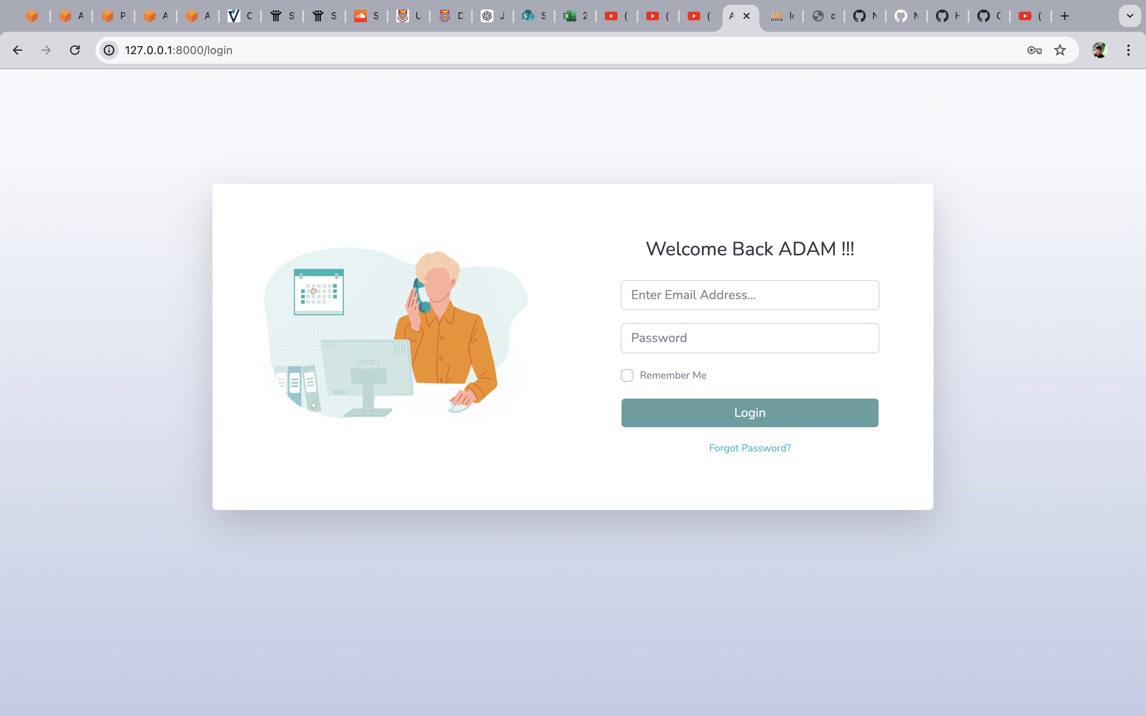
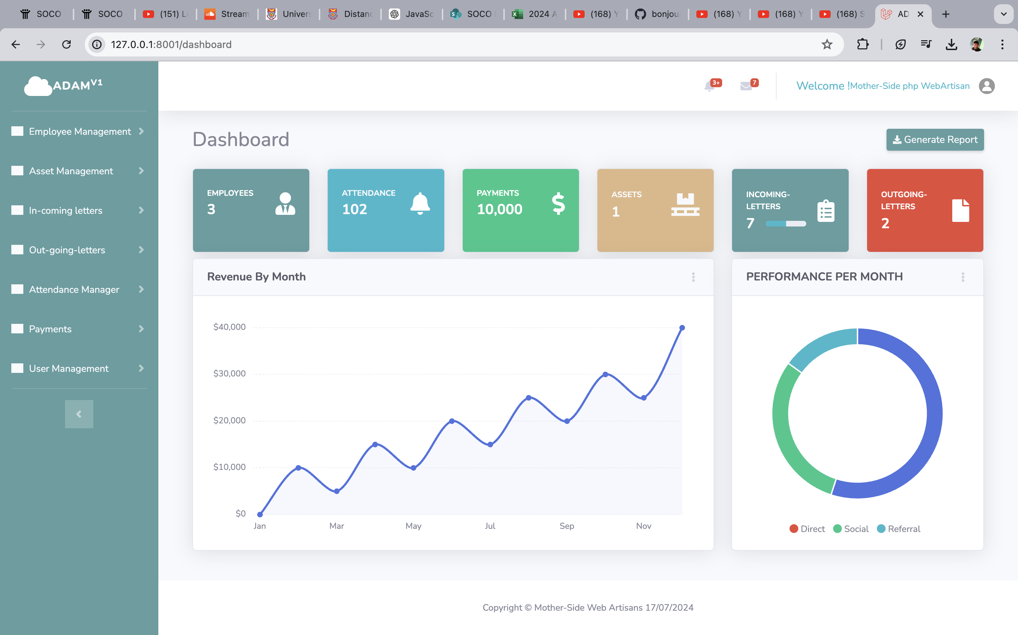
User Interface

Slide 15
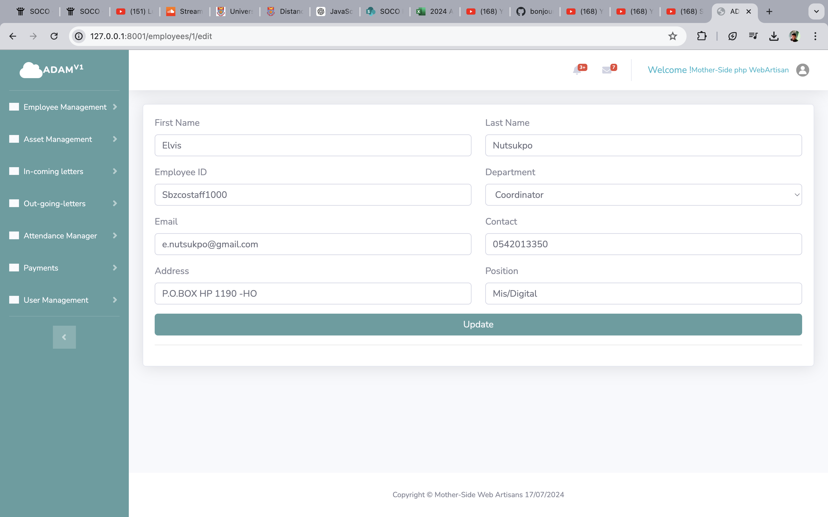
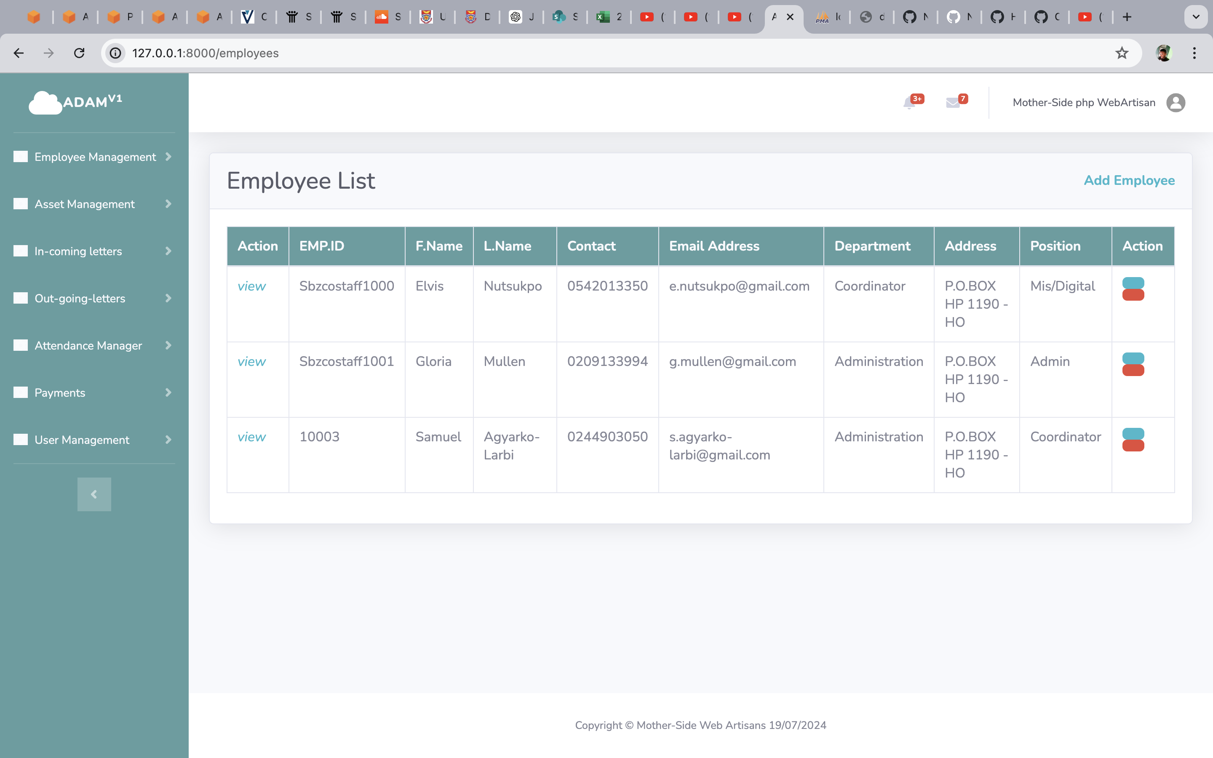
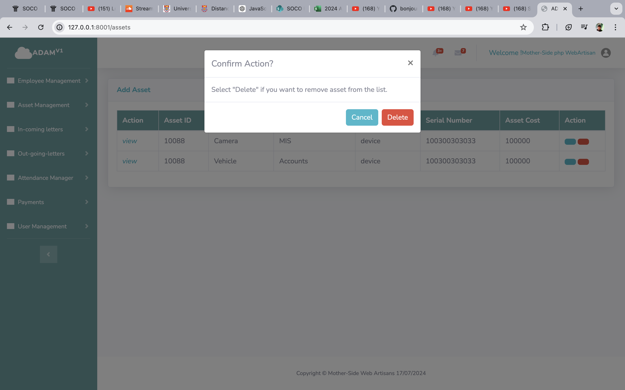
User Interface

Slide 16
Security
User Authentication: Secure login system using Laravel's authentication features.
Authorization: Role-based access control to restrict access to certain sections based on user roles.
Validation: Form inputs are validated to prevent SQL injection and other attacks.
Encryption: Sensitive data such as passwords are encrypted using Laravel's hashing mechanism.

Slide 17
Testing
Unit Testing: PHPUnit is used for testing the individual units of code.
Feature Testing: Laravel's feature testing tools are used to test the application's functionalities.
Manual Testing: Ensuring the user interface and workflows function correctly.

Slide 18
Conclusion
The Administrative Assistant Manager system is a robust solution for managing various administrative tasks within an organization. It leverages Laravel 10 and Bootstrap to provide a seamless and efficient user experience. This documentation serves as a guide for understanding, installing, and using the system effectively.

Slide 19
ABOUT ADAM
Project Name : Administrative Assistant Manager
Developer Name: Elvis Kojo Nutsukpo
Languages : PHP, HTML, CSS, JAVA SCRIPT
FRONT END:HTML, CSS,BOOTSTRAP
BACK END:MYSQL, PHP 8.2
IDE Tool: Visual Studio Code
Database: MySQL
Project Type: Web Application
Project Platform : Laravel 10

Slide 20
Acknowledgments
Immense gratitude to the Ghana-India Kofi Annan Centre of Excellence in ICT (GI-KACE).,
Center Manager Bolgatanga(Mr Christian Danso) and the Research and Innovation Department team(Mr. Eugene,Mr Bismark, Mr Moro and Mr Hermas )
Lots of appreciation to my woman who has been with me during my sleepless nights of coding

